Slide 1

RASA: Building Smart Chat Bot
Swapnil Vishwasrao

Slide 2
Conversational AI with Rasa Core and Rasa NLU
Conversational AI will dramatically change how your users interact with you.

Slide 3
Why Rasa?
Open Source
Highly scalable
No network overhead
Own your data
Tune models for your use case
Deploy anywhere
Complete command on chatbot

Slide 4
Architectural Overview
Input Modules
( RASA NLU )
Query From User
Backend, Database,API, etc
Connector Modules
Dialogue
Management
( RASA CORE )
Response From Bot
Output Modules
( RASA NLG )

Slide 5
Main Components of Rasa
Rasa NLU (Natural Language Understanding)
Rasa Core – Dialogue Management
Rasa NLG (Natural Language Generation)

Slide 6
Rasa NLU
Prepare training data for chat bot.
Writing configuration file.
Choosing pipeline and training the model.
Predicting the intent of text.
Extracting Entities from text.

Slide 7
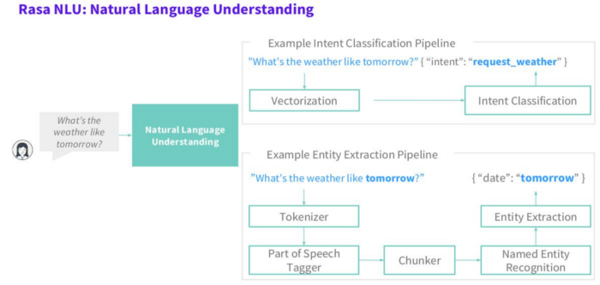
RASA NLU

Slide 8
Pre-defined pipelines
Spacy_Sklearn-
Use pre-trained word vectors from either Glove algorithm
This pipeline is very useful with small sets of data.

Slide 9
Pre-defined pipelines
Tensorflow Embedding-
Doesn’t make use of any pre-trained word vectors like spacy_sklearn,but it adjust itself as per our own provided dataset
The good thing about pipeline is that our word vectors will be as per our domain

Slide 10
Rasa CORE
Dialogue management model to responses back to the user.
Teach the model to create response.

Slide 11
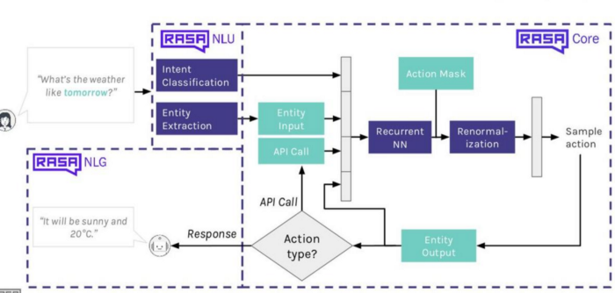
Rasa Core and Rasa NLU work together

Slide 12
Rasa NLG
Chat bot possessing NLG ability.
What exact and clear response to generate for a corresponding user messages.

Slide 13
Final Thoughts: Closing The Loop
New Training Data
Query From User
Correct Training Data
Use improved Model
Retrain ML Model
Relabel Collected Data

Slide 14
Summary
Deep ML techniques help advance state of the art NLU and conversational AI
Combine ML with traditional programming and Rules where appropriate
Highly scalable as different from rule base approach.
Full control on chat bot.

Slide 15
Thank You !

